Slide 1
Fundamentals of Computer Science COMPUTATIONAL THINKING A Gentle Intro

Slide 2
Computational Thinking
CT process starts before writing the first line of code
CT relates to functional skills, not mechanical skills
Just as fundamental as reading, writing and arithmetic

Slide 3
Computational Thinking
What is it?
Understanding people
Evaluation of a problem and solution(s)
Thinking logically
Thinking algorithmically
Rigorous argument and proof
Computational modelling
Abstraction
The 21st century Skill Set

Slide 4
Computational Thinking
Seymour Papert’s justification
“Maths must be taught in a completely new way based on computation”. (Papert, 1972)
As a result all science has changed, not just maths.
Jeanette Wing’s definition
“Computational Thinking is the thought process involved in formulating a problem and expressing its solution(s) in such a way that a computer—human or machine—can effectively carry out.” (Wing, 2006)

Slide 5
Not just any old problem-solving!
How do we think about problems so that computers can help?
Thinking logically and algorithmically – is the problem computable?
Focus on very last detail
Devise efficient ways to do things
Understand people
This is how we have changed the way we do science, shop, run businesses, play games, listen to music…

Slide 6
Not just any old problem-solving!
Thinking like a Computer Scientist - very specific problem-solving skills
Not about humans following instructions on paper or in our heads
Not about thinking like a computer either!
Consists of skills to:
Formulate a problem as a computational problem (abstraction).
Construct a good computational solution for the problem (eg. an algorithm) or explain why there’s no solution.

Slide 7
CT’s Influence
It has changed the way we all live, work and play
Which ones are true?
Helps understand your own brain
Helps understand the digital world
Win wars
Create whole new industries
Save lives
Problem-solving…the computational way!

Slide 8
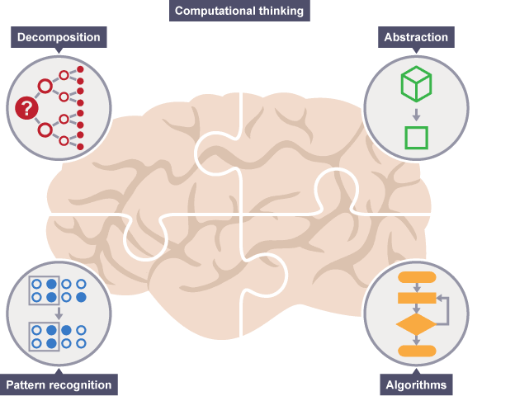
Four key CT concepts
breaking down a complex problem or system into smaller, more manageable parts
focusing on the important information only, ignoring irrelevant detail
developing a step-by-step solution to the problem, or the rules to follow to solve the problem
looking for similarities among and within problems

Slide 9

Decomposition
How would you eat an elephant?
A big complex problem is comprised of smaller (and more easily solved) sub-problems.
Breaking down a complex problem into sub-problems is called decomposition

Slide 10
Decomposition
The process of how to break down a complex problem into sub-problems is called analysis
When the solved sub-problems are put back together - synthesis
When the sub-problems are addressed simultaneously - parallelisation.
Organising and working on multiple sub-problems at the same time.

Slide 11
Decomposition
What happened at the crime scene?
How would you start developing a mobile app?
You need to prepare a research paper – where to begin?

Slide 12

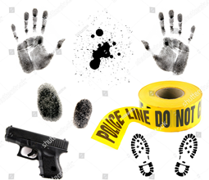

Decomposition – Crime Scene
What happened at the crime scene?
Images courtesy of Flickr

Slide 13
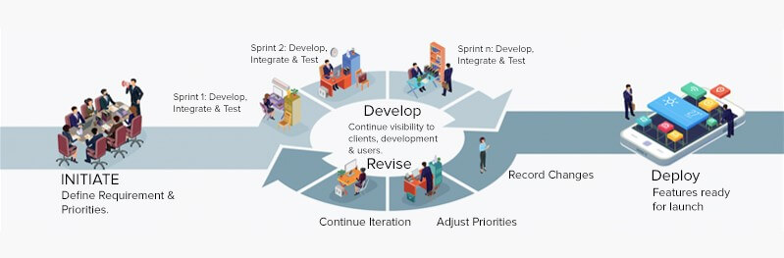
Decomposition – Develop Mobile App using AGILE
Image courtesy of Flickr

Slide 14
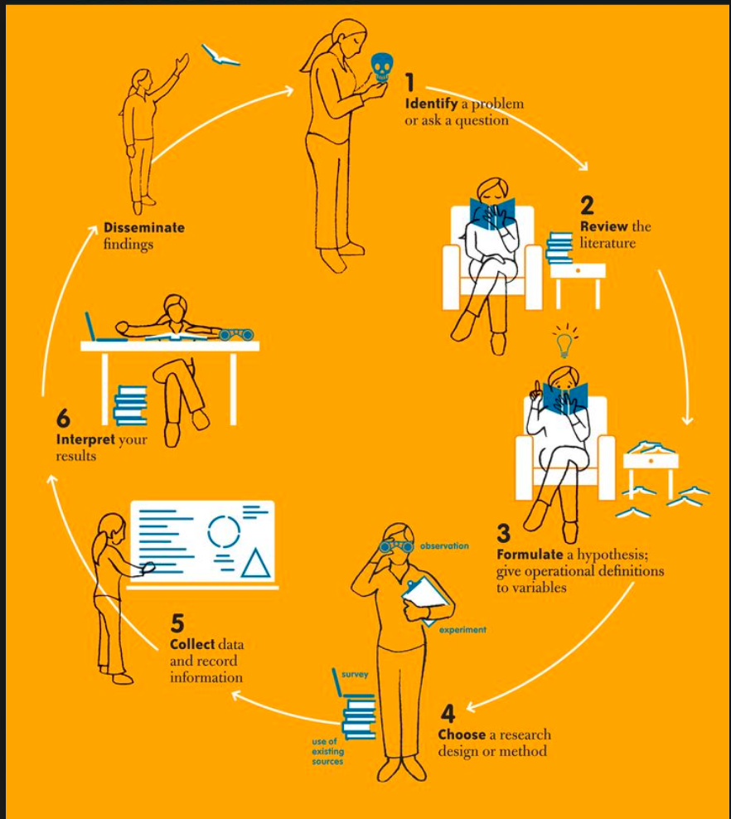
Decomposition – Write Research Paper
Image courtesy of Flickr

Slide 15
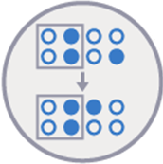
Pattern Recognition
Spotting and using similarities.
An important life skill!
Have you noticed patterns that occur around you?

Slide 16
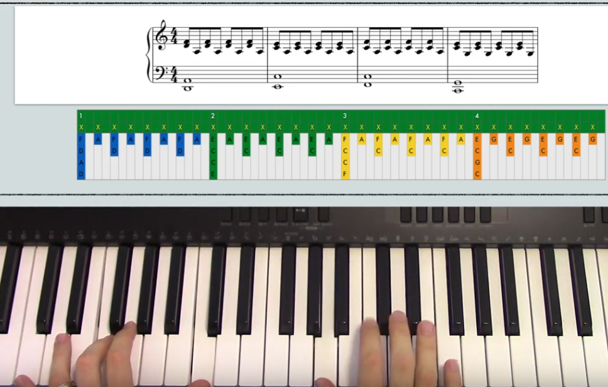
Patterns around us
Rhythmic patterns
https://www.youtube.com/watch?v=wgM3PItWDyA
Image courtesy of YouTube

Slide 17
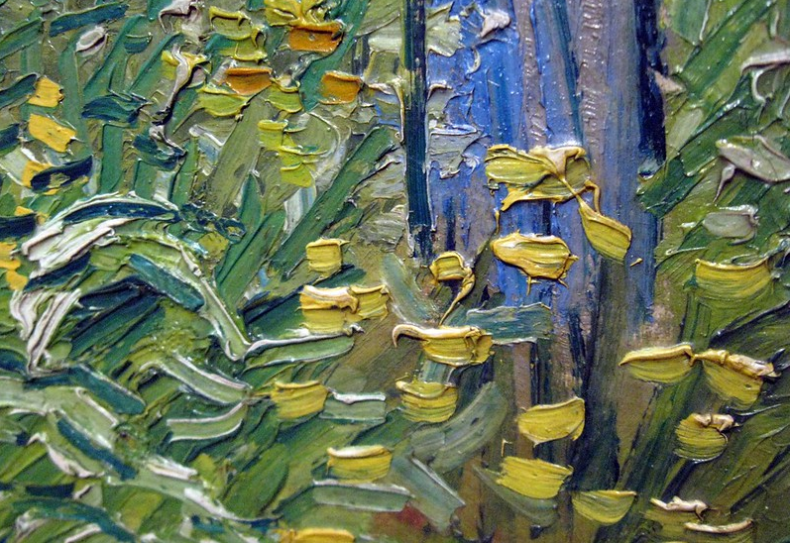
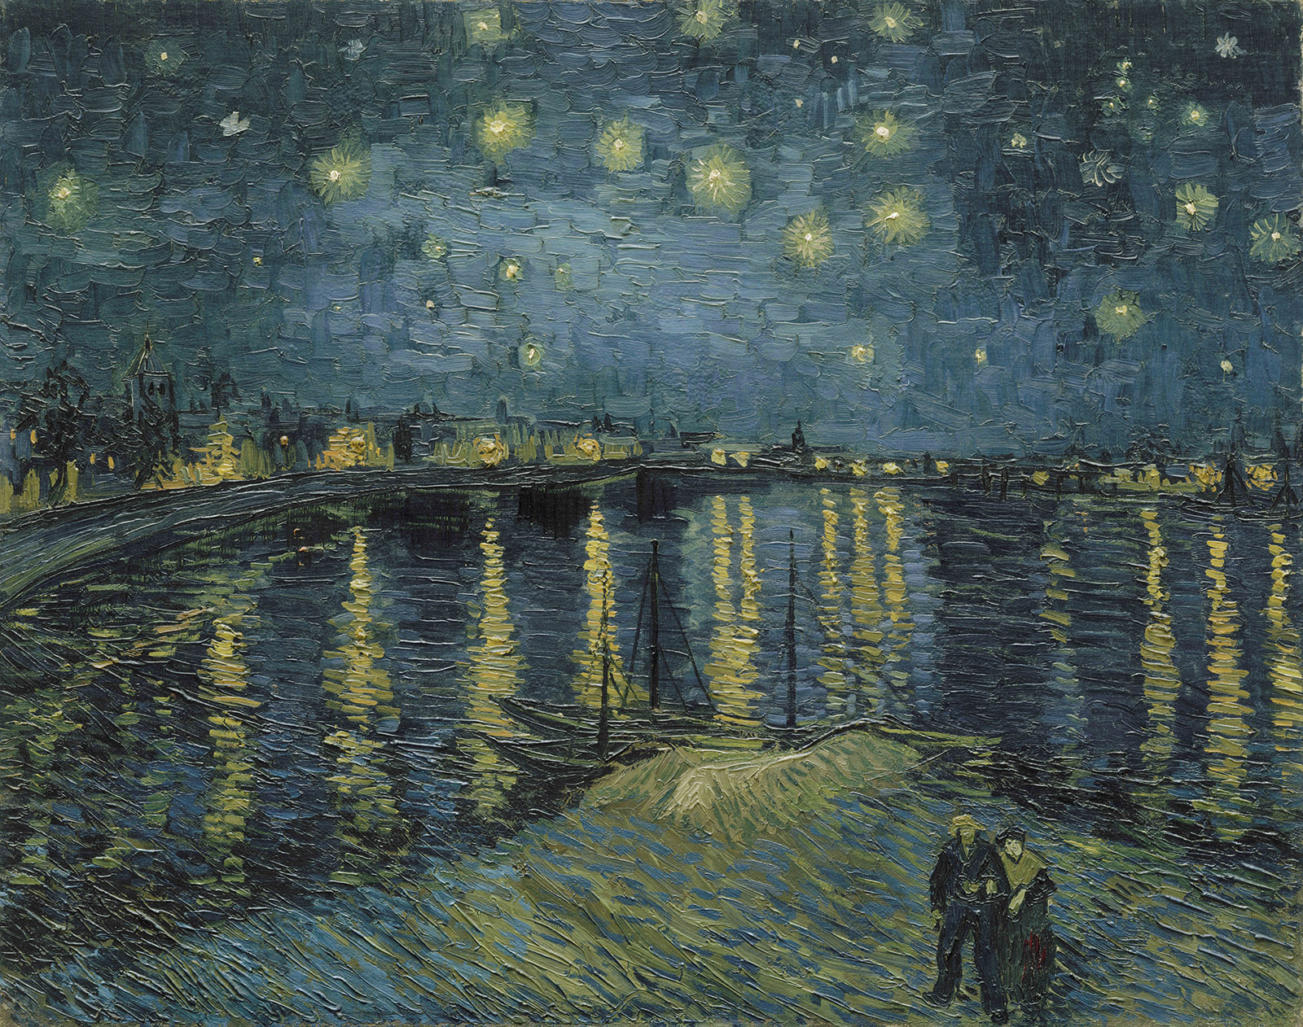
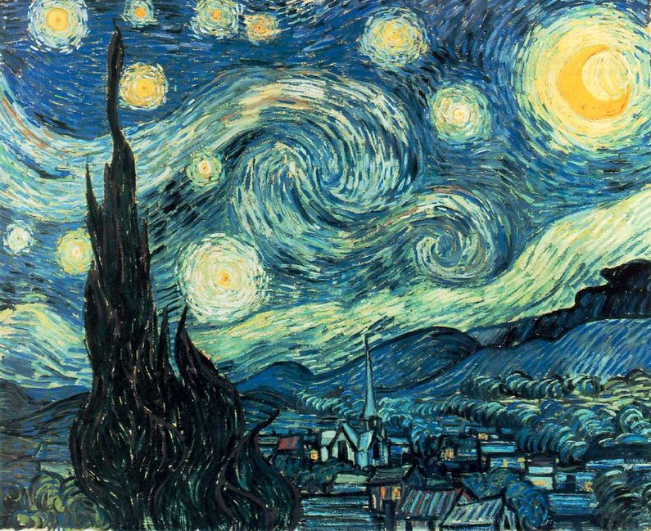
Patterns around us
Brushstrokes in a painting
Images courtesy of Flickr

Slide 18
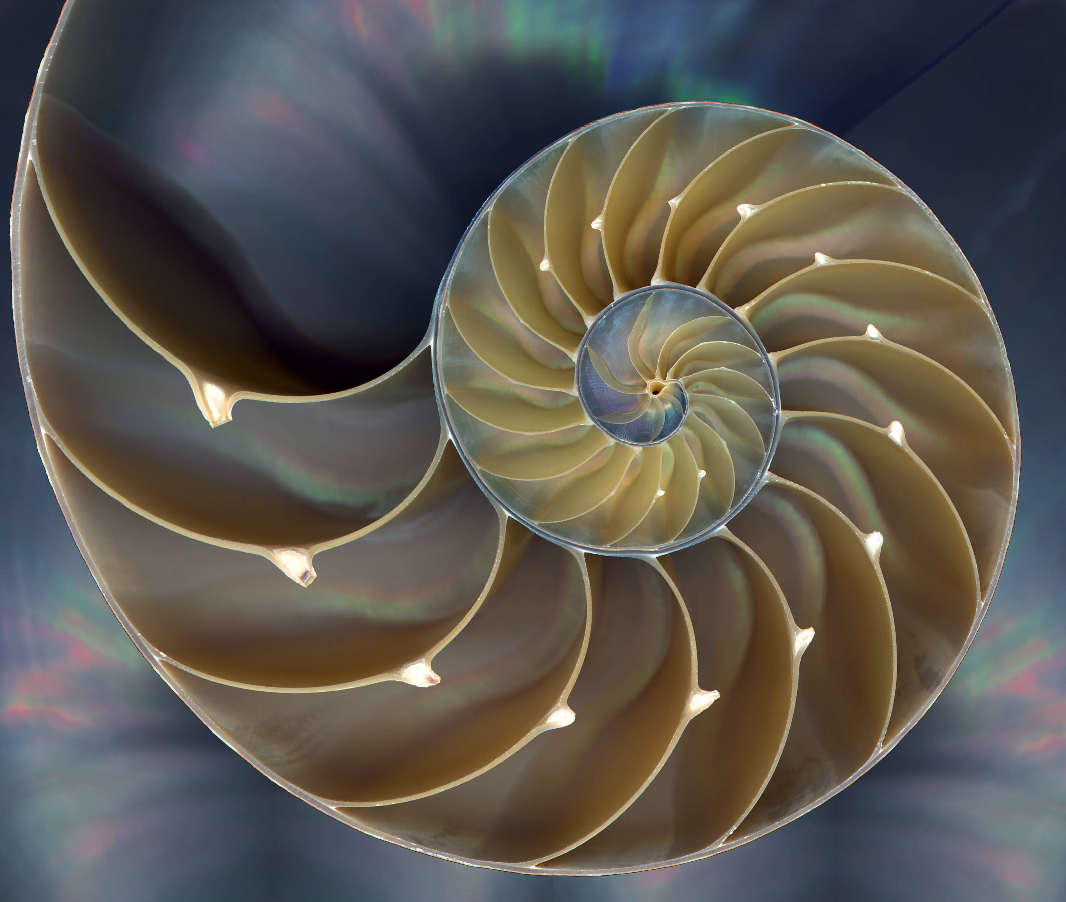
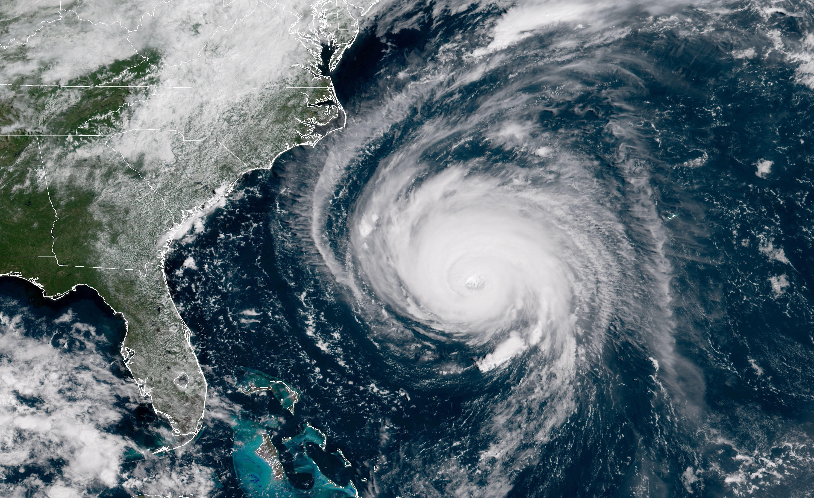

Patterns around us
Patterns in nature
Images courtesy of Imgur

Slide 19
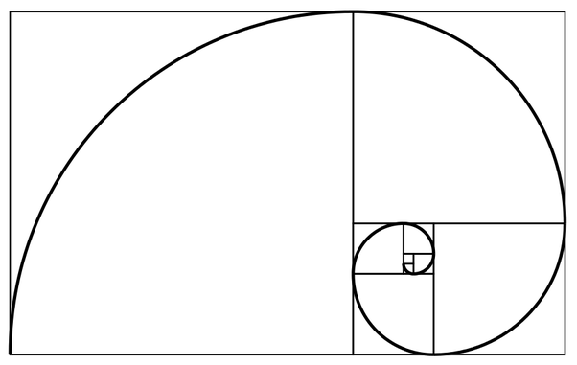
Patterns around us
Patterns in nature – abstracted as Fibonacci Spirals
Each Fibonacci number is equal to the sum of the preceding two numbers

Slide 20
Pattern Recognition
Uses :
identification and authentication: e.g., license plate recognition, fingerprint analysis and face detection/verification
medical diagnosis: e.g., screening for cervical cancer
defence: various navigation and guidance systems, target recognition systems, shape recognition technology etc

Slide 21
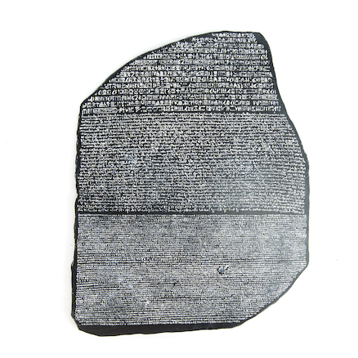
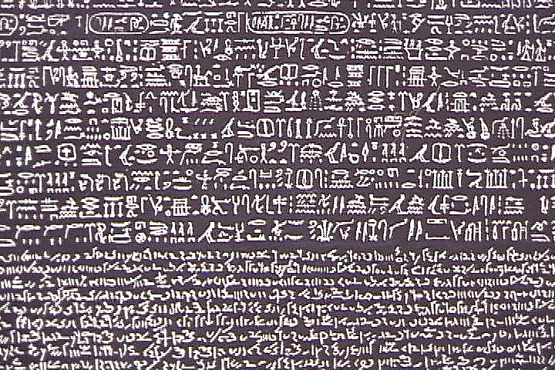
Pattern Recognition – Rosetta Stone
Example the discovery of Rosetta stone led to hieroglyphs to be deciphered.
Application of pattern recognition: bar code and QR code that can only be understood by a computer.

Slide 22
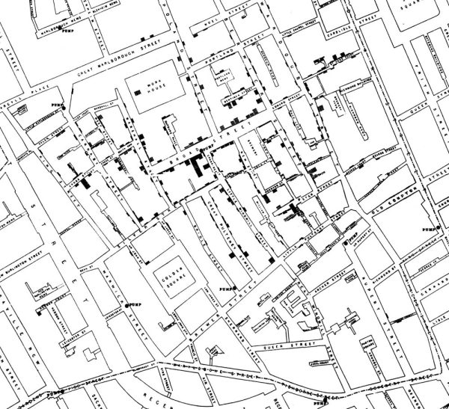
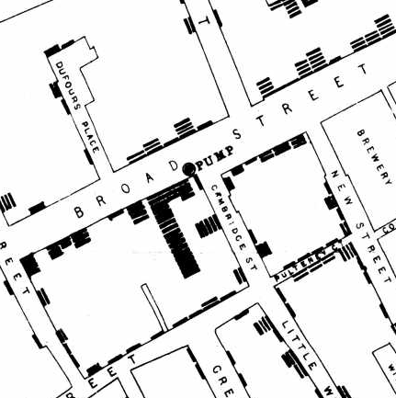
Pattern Recognition – London Cholera
Cholera outbreak – John Snow’s water contamination hypothesis and visualisation.

Slide 23
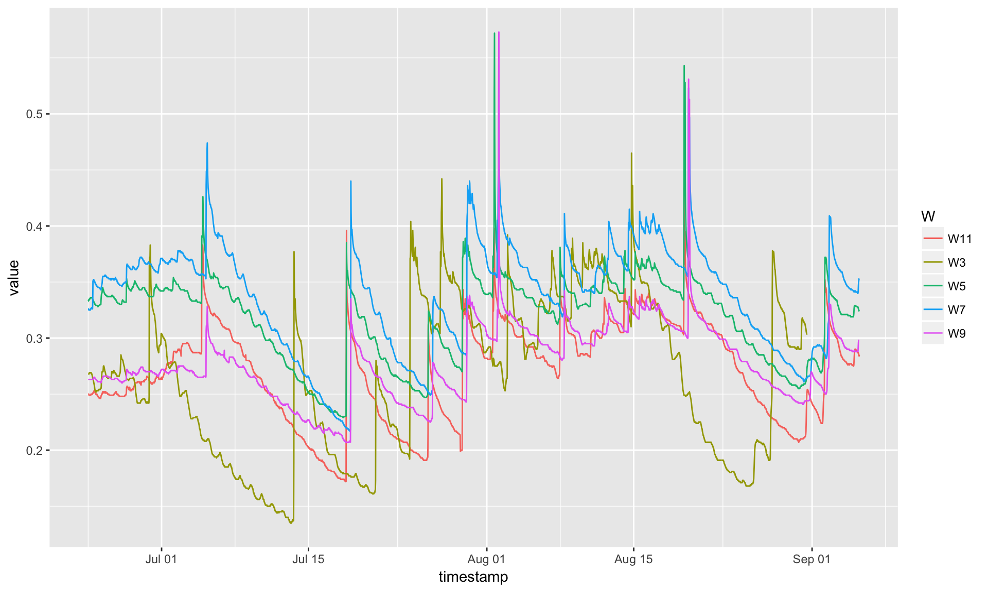
Pattern Recognition
Too much data can be chaotic and overwhelming. We struggle to discern a recognisable pattern.
Too little data and it’s insufficient to discern a recognisable pattern.

Slide 24
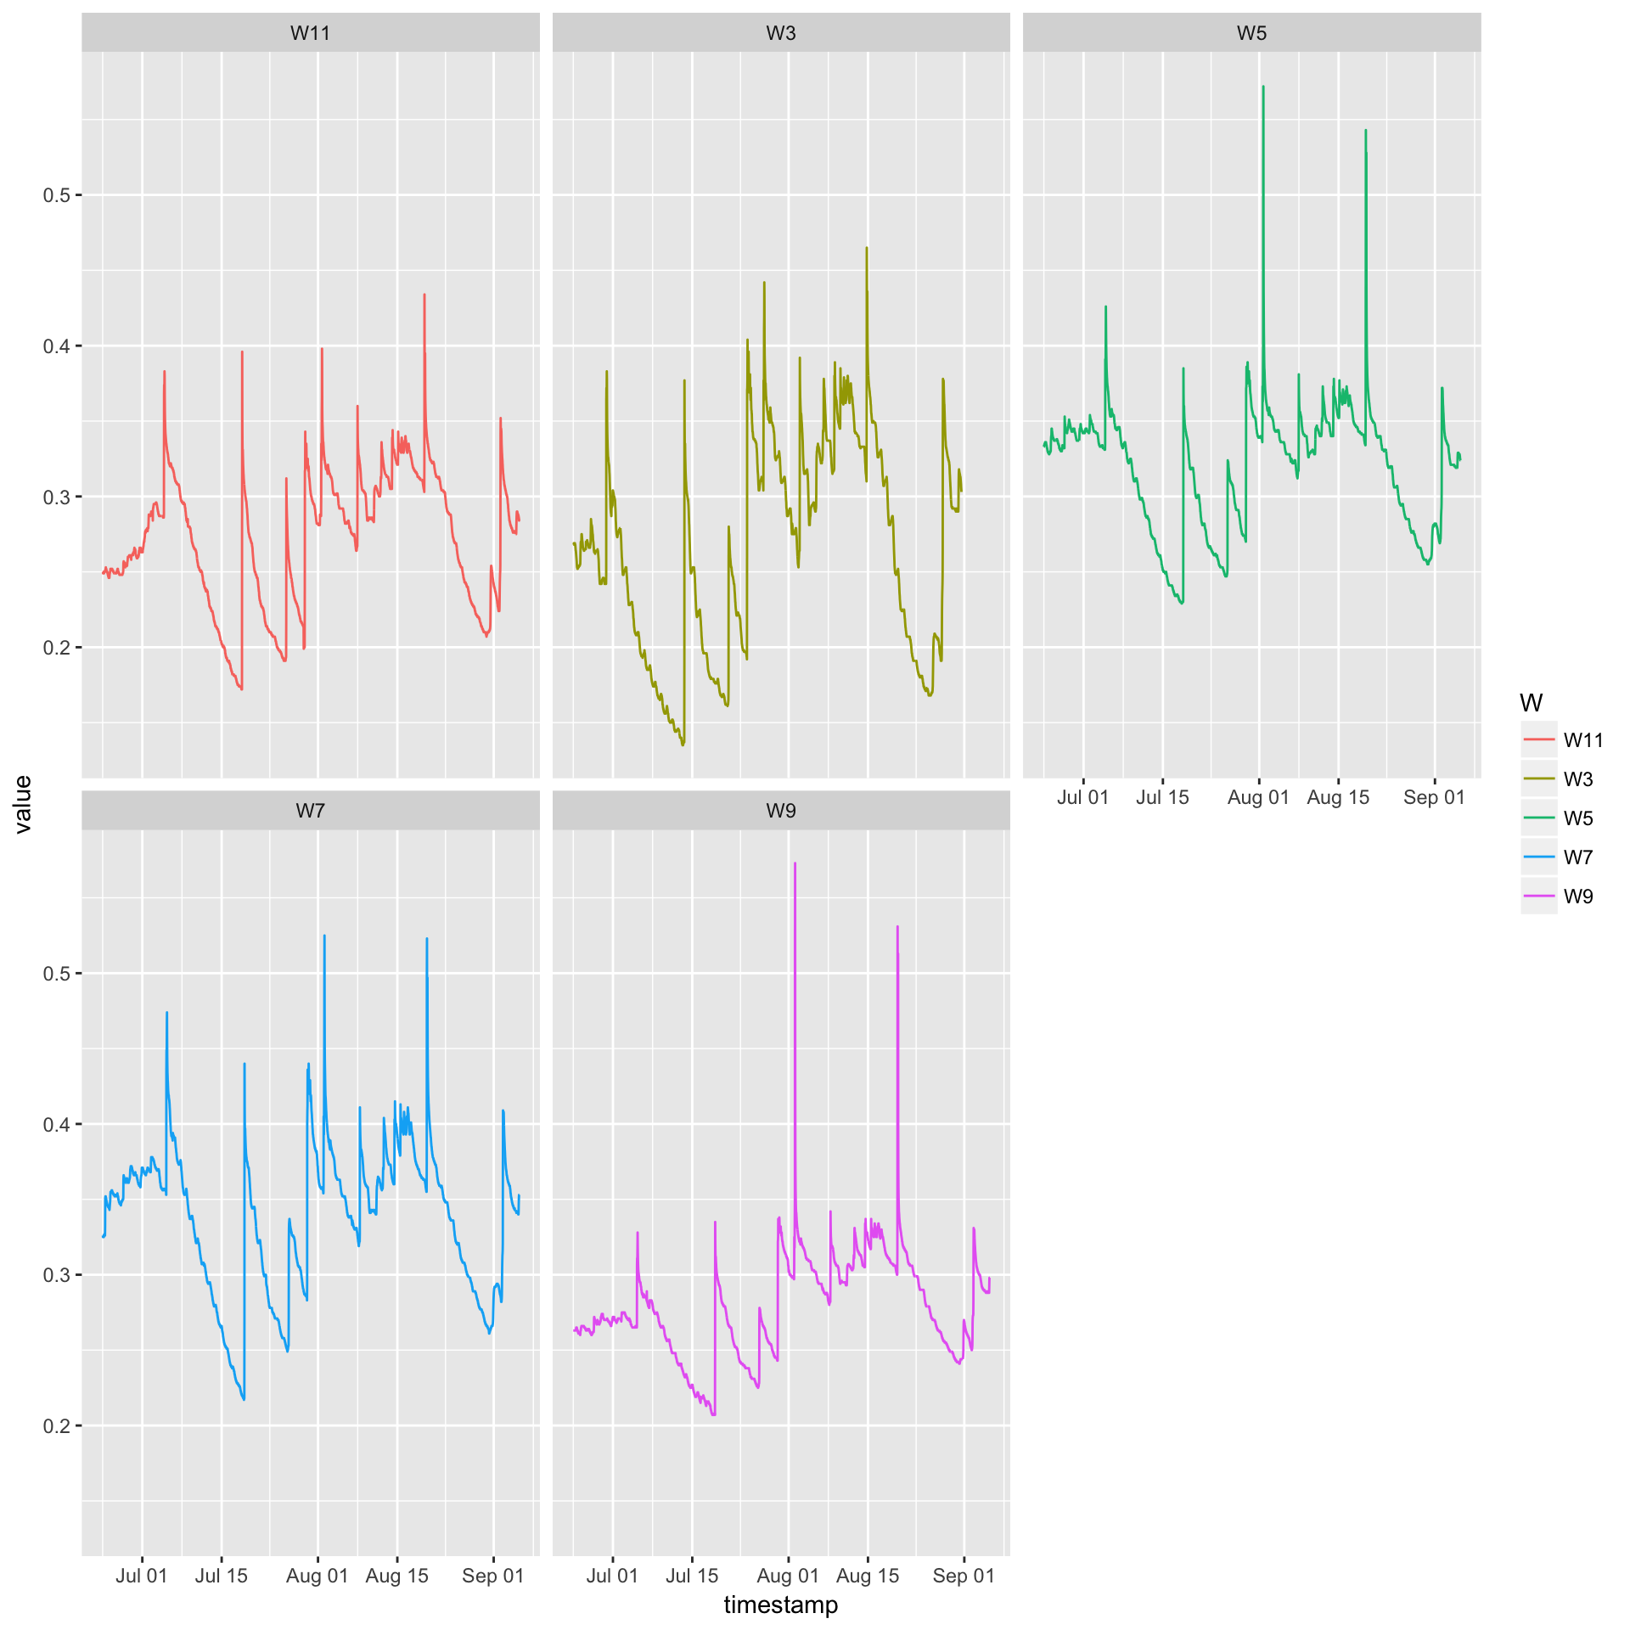
Pattern Recognition
Right amount of data – a pattern are clear and recognisable. We instantly understand the situation.

Slide 25
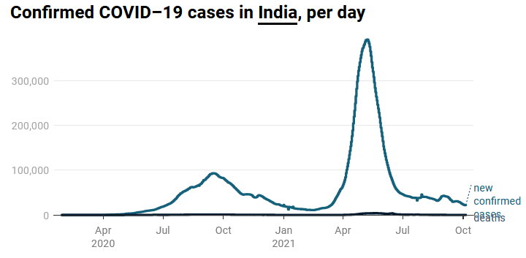
Pattern Recognition
Right amount of data – there seems to be a pattern, and we want to learn more to figure out what’s going on.

Slide 26
Pattern Recognition
Too much or too little data would not be useful to us.
When the amount of data is about right:
We could recognise patterns.
They offer further data visualisation and exploration.
This gives you insight.

Slide 27
Using Vectors for Visualisation
Streamlines as vectors
Visualisations allow us to explore data and solve problems far quicker than ever.
Example of vector: Streamlines are good for showing flows.
Is this visualisation effective:
Magnitude?
Direction?
Orientation?

Slide 28
Pattern Perception
Vectors show movement from one point to another
Shows magnitude and direction
Four flow visualisation techniques evaluated by Laidlaw et al (2001)

Slide 29
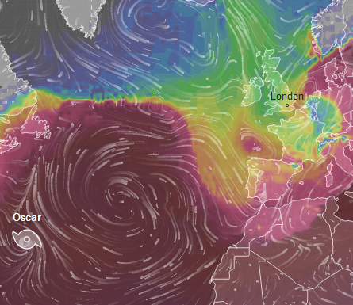
Pattern Recognition
Visualisations allow us to explore data and solve problems far quicker than ever possible.
www.ventusky.com
Real-time visualisation of wind, rain and temperature data.
Presented on maps. Detailed forecast for your place.
Data visualised using the best weather forecast models.

Slide 30
More key concepts for 2 weeks! References Laidlaw, D. H., Davidson, J. S., Miller, T. S., da Silva, M., Kirby, R. M., Warren, W. H., & Tarr, M. (2001). Quantitative comparative evaluation of 2D vector field visualization methods. In Proceedings of the Conference on Visualization'01 (pp. 143-150). IEEE Computer Society. Papert, S. (1972). Teaching children to be mathematicians versus teaching about mathematics. International journal of mathematical education in science and technology, 3(3), 249-262. Wing, J. M. (2006). Computational thinking. Communications of the ACM, 49(3), pp. 33-35.

